Slide 1
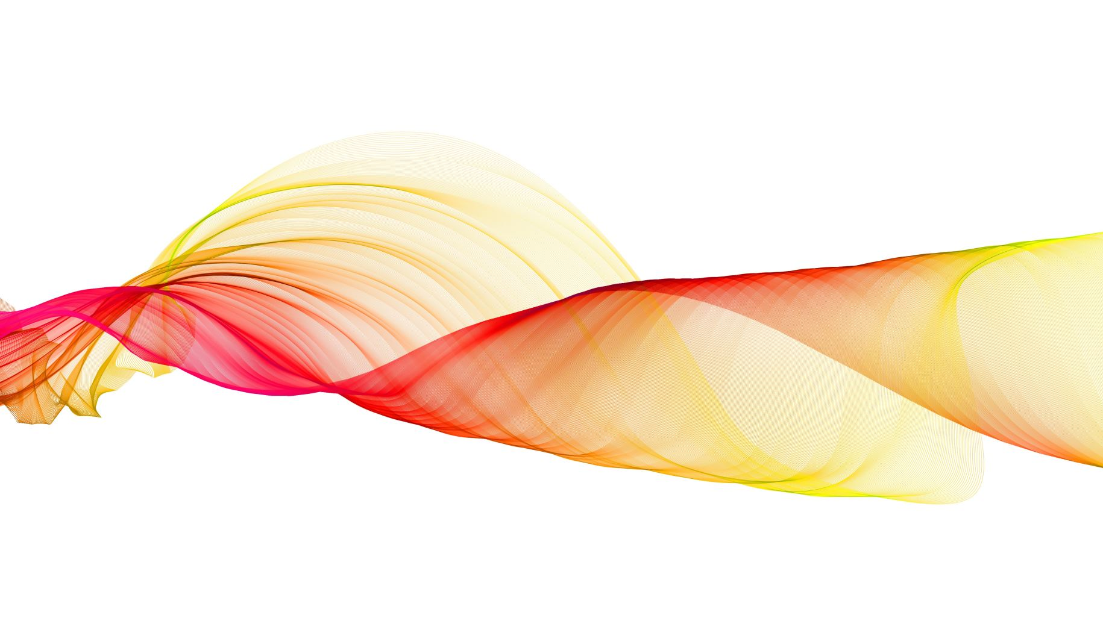

Segmentation of Medical Images Using UNet Architecture
Presentation by – Karthik Rajeev(21BCE1349)
Abhimanyu Jai Menon(21BCE1613)
Hardik Arora(21BCE1222)

Slide 2
Introduction
Medical Image Segmentation: An Essential Tool in Modern Healthcare
Medical image segmentation is a vital process in healthcare that involves partitioning medical images into meaningful regions. These regions often correspond to anatomical structures, lesions, or other clinically significant areas, enabling precise analysis for diagnosis and treatment.
Importance of Medical Image Segmentation
Identification of Anatomical Structures:
Medical imaging techniques like MRI, CT scans, and ultrasounds generate complex visuals of the human body. Segmentation aids in isolating critical structures such as organs, blood vessels, or tissues for detailed examination.
For example, accurate liver segmentation from a CT scan allows specialists to assess liver health and detect diseases like cirrhosis or tumors.

Slide 3
2. Detection of Lesions and Abnormalities:
Segmentation is crucial in identifying abnormalities like tumors, polyps, and skin lesions.
For instance, segmenting malignant and benign lesions in breast ultrasound images helps differentiate between cancerous and non-cancerous conditions, guiding early intervention.
3. Precise Delineation:
Segmentation provides clear boundaries for regions of interest, ensuring that subsequent analyses—such as volume measurement or tissue density evaluation—are accurate.
For example, segmenting the brain's ventricles can help detect neurological disorders like hydrocephalus.

Slide 4
applications
1. Tumor Detection:
Enables identification and localization of tumors in various imaging modalities (e.g., MRI for brain tumors or CT scans for lung nodules).
Accurate segmentation allows oncologists to plan surgeries, radiation therapy, or chemotherapy with precision.
2. Organ Delineation:
Essential for surgical planning and intervention, where precise knowledge of organ boundaries minimizes damage to surrounding tissues.
Examples include prostate segmentation for radiation therapy or liver segmentation for transplant assessment.
3. Polyp Detection:
Helps in early detection and removal of polyps in the gastrointestinal tract using colonoscopy images.
Automated segmentation models reduce the chances of missed detections, improving patient outcomes.

Slide 5
benefits
1. Accurate Diagnosis:
By isolating specific regions, segmentation helps radiologists and physicians identify diseases with greater precision.
For example, automated segmentation of retinal layers in OCT scans can aid in diagnosing diabetic retinopathy or macular degeneration.
2 .Timely Treatment Planning:
Segmentation accelerates the diagnostic workflow by providing structured and interpretable image data.
In oncology, segmented tumor regions enable tailored treatment plans, ensuring optimal therapy outcomes.
3. Enhanced Patient Care:
Facilitates monitoring disease progression over time by comparing segmented images from different visits.
Improves patient safety by reducing human error in manual segmentation and planning.

Slide 6
Why unet ?
1. Core Task: Tumor Segmentation
Objective: Accurately segment breast tumors from ultrasound images, differentiating between normal and abnormal regions.
UNet's Role:
The encoder-decoder architecture provides pixel-level precision in identifying tumor boundaries.
Skip connections help retain high-resolution spatial details, critical for distinguishing subtle tumor features in ultrasound images.

Slide 7
2. Handling Dataset Challenges
Objective: Work effectively with the BUSI dataset, which contains limited annotated images.
UNet's Role:
Designed to perform well on small datasets, leveraging its ability to learn from fewer examples without overfitting.
Effective in balancing feature extraction and localization even in datasets with variability (e.g., differences in tumor size, shape, or ultrasound artifacts).
3. Boundary Localization
Objective: Ensure precise delineation of tumor boundaries to support clinical analysis.
UNet's Role:
Skip connections ensure the decoder path can reconstruct fine details and sharp edges of segmented regions.
Helps differentiate closely overlapping structures, such as separating tumors from surrounding tissue.

Slide 8
4. Generalization Across Variability
Objective: Handle variability in ultrasound image quality and tumor characteristics.
UNet's Role:
Robust encoder-decoder structure generalizes well to differences in imaging artifacts and noise.
Adaptable to the nuances of medical imaging modalities like ultrasound, where contrast and resolution vary significantly.
5. Output Predictions
Objective: Provide accurate segmentation masks for diagnostic purposes.
UNet's Role:
Outputs clear, interpretable masks that align with clinical requirements, helping in distinguishing normal, benign, and malignant areas.

Slide 9
6. Basis for Future Enhancements
Objective: Build a foundation for extending the model to advanced architectures or other medical segmentation tasks.
UNet's Role:
Serves as a starting point for incorporating attention mechanisms (e.g., Attention UNet) or hybrid approaches for improving boundary detection and contextual understanding.

Slide 10
Problem statement
Medical image segmentation remains a challenging task due to the complexities of medical imaging and the limitations in resources. Specific challenges in this context include:
Manual Annotation is Labor-Intensive:
Annotating medical images requires domain expertise from radiologists or clinicians, making the process time-consuming and expensive.
Variability in manual segmentation between experts can lead to inconsistencies.
Dataset Limitations:
Medical datasets often suffer from privacy restrictions and limited availability of annotated data.
This scarcity can hinder the development of robust machine learning models.

Slide 11
1. High Intra- and Inter-Class Variability:
Tumors and lesions exhibit significant variability in shape, size, and texture across patients.
Differences in imaging modalities (e.g., ultrasound noise or low contrast) make segmentation even more complex.
2. Clinical Need for Precision:
Inaccurate segmentation can lead to misdiagnosis or ineffective treatment.
Segmentation must delineate fine boundaries, crucial for identifying malignant tissues or guiding surgical procedures.
Project Context:
In our project, these challenges are addressed by leveraging deep learning techniques with UNet to automate and enhance breast tumor segmentation, focusing on distinguishing normal, benign, and malignant regions in ultrasound images.

Slide 12
Advantages of unet
1. Pixel-Level Segmentation:
UNet's encoder-decoder structure enables precise identification of tumor boundaries at the pixel level.
2. Skip Connections:
Retains spatial and contextual information lost during downsampling in the encoder.
Combines low-level details with high-level features, crucial for identifying subtle features in medical images.
3. Small Data Efficiency:
Performs effectively with the limited annotated data available in the BUSI dataset.
4. Generalizability:
Robust to variations in tumor size, shape, and texture, as well as ultrasound imaging artifacts like noise or low contrast.

Slide 13
Relevance to the Project:
The encoder extracts meaningful features like tumor textures.
The decoder reconstructs these features into segmentation masks, differentiating tumor regions from normal tissues.
Skip connections ensure no critical spatial details are lost, crucial for tumor diagnosis.

Slide 14
Models used
UNET Overview :
Structure:
Encoder: Extracts hierarchical features using convolutional layers and max-pooling.
Decoder: Recovers spatial resolution via transposed convolutions and combines it with encoder features via skip connections.
Output Layer: Applies a sigmoid activation to generate segmentation masks.
Strengths:
Captures both global and local contexts.
Accurate boundary detection and fine-grained segmentation.

Slide 15
Comparison with other models
DeepLab:
Employs atrous convolutions for multi-scale feature extraction.
Effective for large-scale organ segmentation but less tailored for detailed boundary localization in small tumors.
Attention Models:
Use spatial attention to focus on relevant image regions, enhancing segmentation accuracy in complex datasets.
Potential future enhancement for our project.
Hybrid Architectures:
Combine encoder-decoder designs with advanced features like recurrent layers or frequency recalibration for improved sensitivity and specificity.

Slide 16
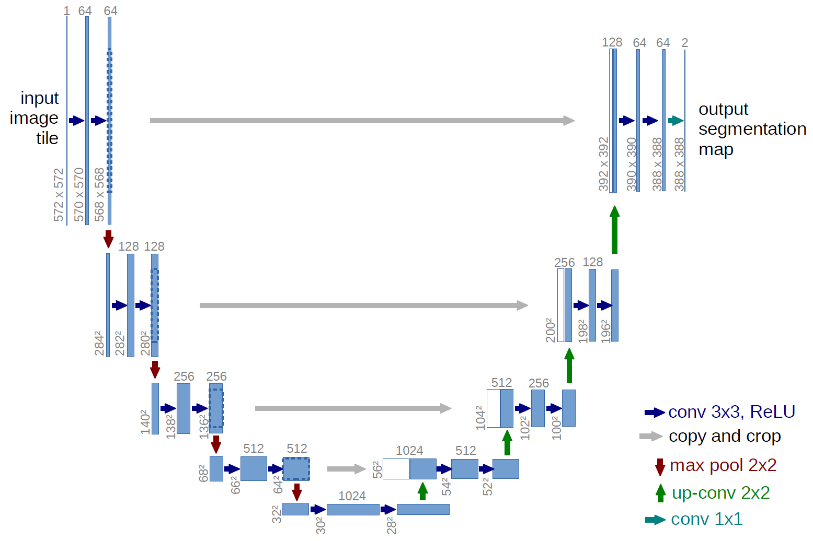
Unet structure

Slide 17
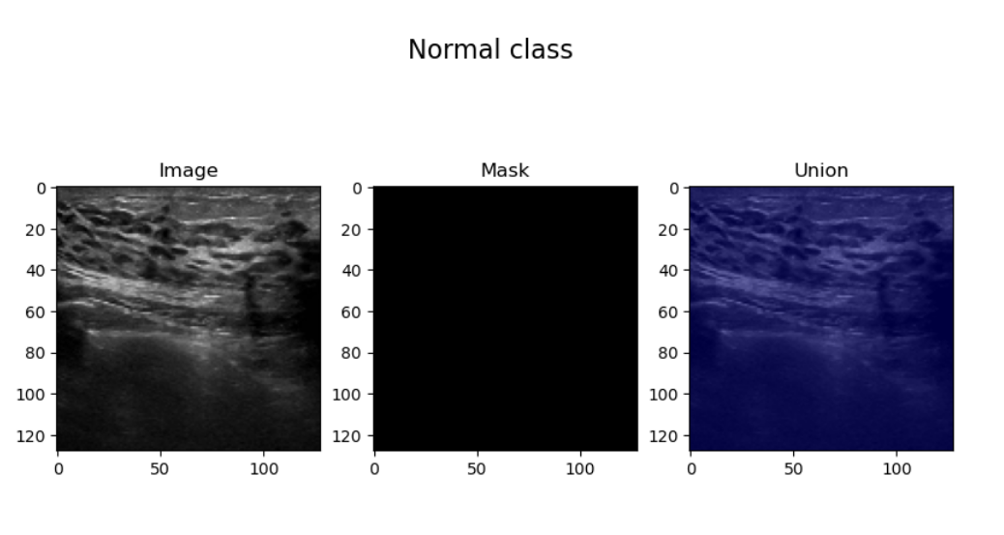
outputs
Data of each class :
Normal

Slide 18
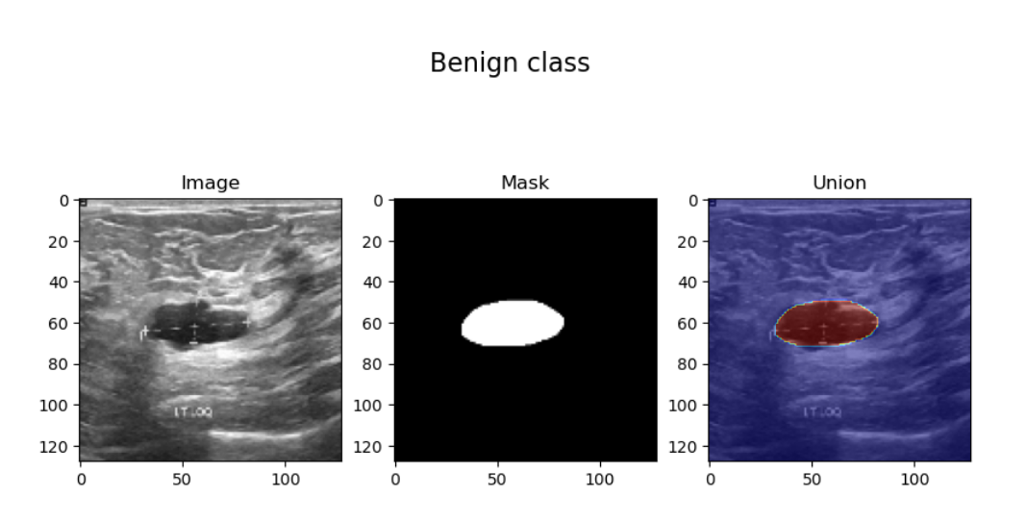
Benign class :

Slide 19
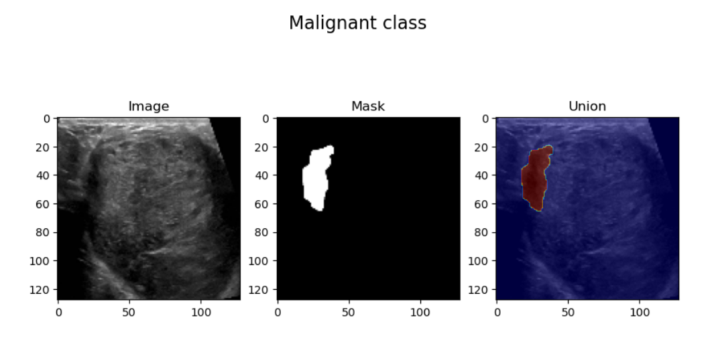
Malignant class :

Slide 20
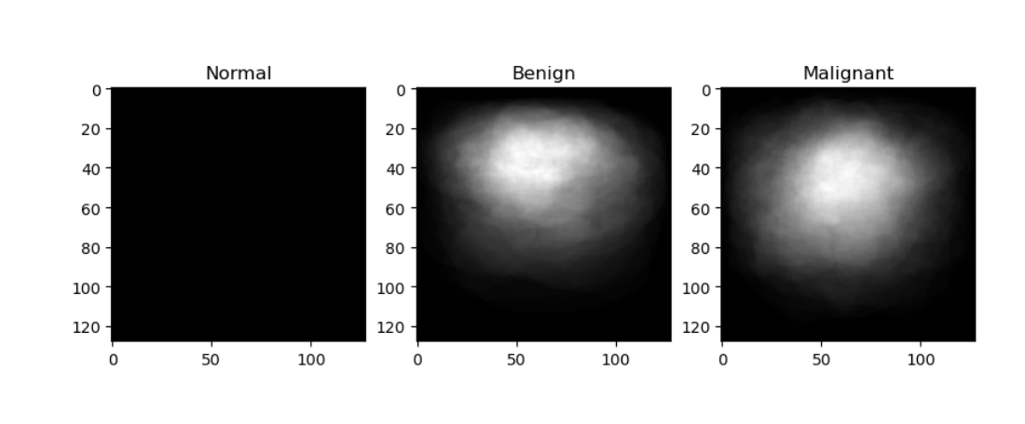
Average view of masks in each class :

Slide 21
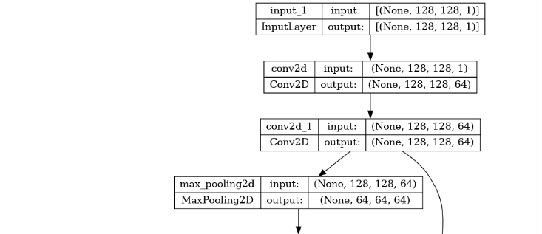
Model plotting

Slide 22
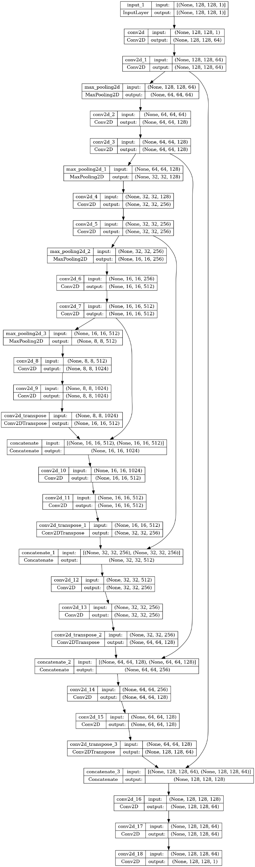

Slide 23


Slide 25
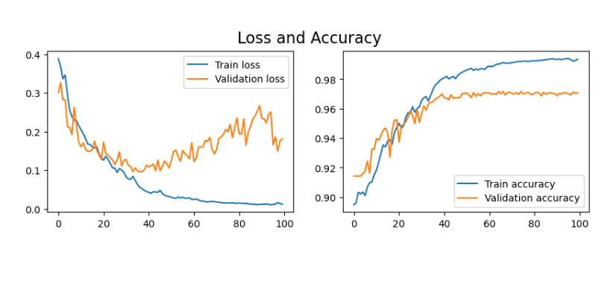
Loss and accuracy

Slide 26
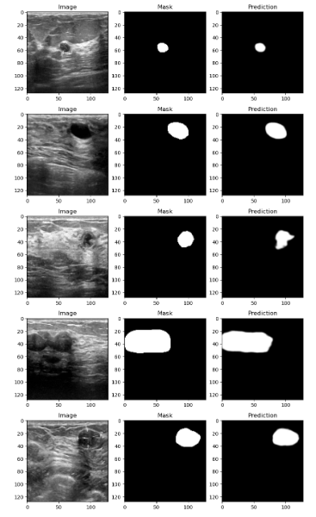
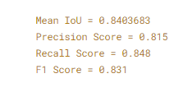
results

Slide 27
Future work
1. Advanced Architectures:
Integrate attention mechanisms (e.g., Attention UNet) for improved focus on tumor regions.
2. Dataset Expansion:
Train on diverse datasets to improve generalization across imaging modalities.
3. Real-Time Applications:
Optimize the model for deployment in clinical workflows with faster inference times.
4. Explainability:
Develop interpretable models for clinical trust and adoption.

Slide 28
conclusion
Summary:
UNet effectively segments breast ultrasound images, enabling early detection and diagnosis of tumors.
Its encoder-decoder structure with skip connections ensures accurate and detailed segmentation.
Outlook:
Continued innovation in architectures and training techniques will enhance performance and broaden clinical applicability.

